Slide 2
Salafists
The word Salafist derives from the Arabic root word “Salaf,” which means predecessors or ancestors.
The predecessors are the Righteous Salaf (Salaf al-Salih) (pious ancestors).
The Righteous Salaf are Prophet Muhammad and the first four Caliphs: Abou Bakr, Omar, Uthman, and Ali (632-661).
Prophet Muhammad’s beginning of revelation 610 until death of Ali 661.
Some Scholars consider the period from 610 until 855, the time of Ibn Hanbal’s death.

Slide 3
The word is pre-modern and historically refer to a distinctive theological group identified with Ahl al-Hadith (Sayings).
Term found in Ibn Taymiyya’s works (d. 1328).
Ibn Taymiyya wrote:
“As for the Salafiyya it is as al-Khattabi and Abu Bakr al-Khatib and others have stated: The way of the Salaf is to interpret literally the Koranic verses and hadiths (sayings) that relate to the Divine attributes and without indicating modality and without attributing to Him anthropomorphic qualities.”

Slide 4
Salafiyah, as it historically emerged, is not simply about physical aspects of God; more crucially it is about how to approach the texts of revelation and who is to be considered a true believer.
As such, the theology of Salafiyah bolsters claims that involve:
1- A return to the authentic beliefs and practices of the first generations of Muslims (Righteous Salaf).
2- A period that began in 610 and ended 661 (or 855).
3- An emphasis on a particular understanding of Tawhid (God’s Oneness), which Salafists divide into three categories of belief and action:

Slide 5
A) Tawhid al-Rububiyya (Oneness of Lordship): Salafists assert that God has certain powers as the Lord of Creation and to attribute any of these to other than Him constitutes unbelief (Kufr).
B) Tawhid al-Uluhiyya (Oneness of Godship): Salafists assert that all forms of worship must be directed exclusively towards God and no one else, and to worship other than God constitutes unbelief.
C) Tawhid al-Asma’ wa al-Sifat (Oneness of the Names and Attributes): Salafists assert that this form of Tawhid involves believing in the depiction of God as it is presented in the texts of revelation without inquiring about modality or metaphorical interpretation.

Slide 6
Shi’a Infallible
Imams
Muhammad
Fatima
1-Ali
d.661
F
2-Hasan
d.669
3-Hussein
d.680
4-Ali Zayn
d.714
5-Muhammad
d.731
Zayd
d.740
Ismail
d.760
6-Ja’far
d.765
7-Musa
d.799
Al-Mahdi
Al-Mahdi
8-Ali
d.818
9-Muhammad
d.835
Fatimid
Caliphs
10-Ali
d.868
11-Hasan
d.874
12-Al-Mahdi
Robert G. Rabil

Slide 7
Sunni
Shi’a
Koran
Sunna:
Practices and
Customs
Shi’a Infallible
Imams
Shari’a:
Islamic Law
Al-Mahdi
Robert G. Rabil

Slide 8
Shi’a
Twelver Shi’a
Ismaili
Alawis
Druzes
Robert G. Rabil

Slide 9
4- Making certain that unbelief is fought, especially all forms of associating other beings or things with God (Shirk).
5- Claiming that the only valid sources of authority are the Koran and the Sunna (latter include hadiths and consensus of Prophet’s companions).
6- Ridding Muslims of the reprehensible innovations (bida’).
7- Arguing that a strict interpretation of the Koran and Sunna is sufficient to guide Muslims for all time and through all contingencies.
Consequently, Salafists believe that true belief is constituted by both inner faith and manifest action. The focus on one theological interpretation excludes and excommunicates adherents of other views.

Slide 10
Sunni Islam
Hanafi
Hanbali
Maliki
Shafi’i
Deobandi
Wahhabi
Muslim Brotherhood
Hassan Bannah
Mawdudi
Sayyid Qutb
Taliban
Salafists
Quietests
Harakis (activists)
Salafi-Jihadis
By Robert G. Rabil

Slide 11
Saudi
Political
Authority
Salafism
Saudi Institutions
Quietests
Activists
Or
Harakis
Jihadis
1- Quietests are apolitical and favor creating a Salaf (Derives from al-Salaf al-Saleh or Pious ancestors, mainly the Rightly Guided caliphs Abu Bakr, Omar, Uthman and Ali 632-661 CE) society through indoctrination and education.
2- Activists assert their claim to politics on account of what they consider the miserable failure of the politics of Arab rulers, especially in the Kingdom.
3- Jihadis (Salafi-Jihadis) believe that change could only come through violence and that purists and politicos are wasting their time.
By Robert G. Rabil

Slide 12
Al-Qaeda
Afg.Pak.
Shabab
Somalia
AQIM
Maghreb
AQIM
Arabian Pen
Nusra Front
Syria
Qaedat
Al-Jihad
Khorasan
Syria
Al-Qaeda in
Iraq
Islamic State
Nusra Front
Al-Qaeda in Iraq and Sham
By Robert G. Rabil

Slide 13
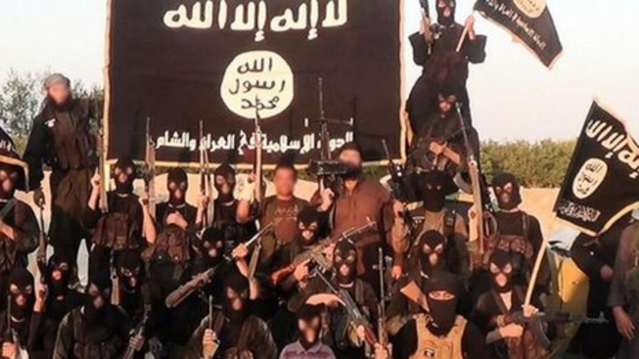

Slide 14
